Slide 1

How do we know?
Syllabus Aspect- the evidence for the emergence and establishment of ancient societies, including art,
iconography, writing, tools and pottery
The Evidence for the Establishment of Ancient Societies.

Slide 2


Listen and look as we go through the following and then be ready to answer some related questions.

Slide 3

There is evidence to support the theory that Homo Sapien Sapiens migrated and slowly populated most of the planet.
Archaeologists have found many of these clues. There are many different types of clues.
Archaeologists search for the remains of human civilisations (artefacts)including bones, statues, pottery and buildings.

Slide 4
Archaeologists find and put together the clues to learn out about our ancestors.
Using the evidence, we can discover many things including:
-When humans came to an area.
How they lived.
How long they lived.
Their lifestyle, food, diseases and many other things about our ancestors.

Slide 5
We can tell how long ago humans came to an area by finding the clues they left behind and using different scientific methods to date these clues
What examples of possible clues can you think of?

Slide 6
Possible clues include…
Footprints that have been preserved.
Tools, weapons and jewellery.
Buildings/shelters.
Artworks.
Graves (human remains and burial goods)
Pottery
Ancient rubbish piles
There are also many more clues archaeologists use.

Slide 7
Dating of Artefacts
There are many ways in which archaeologists (with the help of specialist scientists) can date artefacts including:
Radio-carbon dating- scientists can read the ‘carbon signature’ and use this to date items because they know the rate at which carbon deteriorates.
Tree-ring dating (dendrochronology) can be used to match items with similar ‘atmosphere readings’ and growth cycles.
Stratification (stratigraphy)- how deep an items is buried gives information about its age (usually the deeper it is the older it is).
Matching artefacts to ancient writings when available.
Geology.
Patterns and styles of pottery unique to a particular era and place.
THESE AND OTHER METHODS HELP TO DATE ARTEFACTS AND EARLY HUMAN SETTLEMENTS, BUT SOMETIMES THESE DIFFERENT METHODS COME UP WITH DIFFERENT DATES. BECAUSE OF THIS AND THE HUGE EXPANSE OF TIME WE ARE DEALING WITH, THERE IS SOME DISAGREEMENT BETWEEN HISTORIANS ON THE EXACT TIME PERIOD FOR SOME CULTURES AND ARTEFACTS.

Slide 8
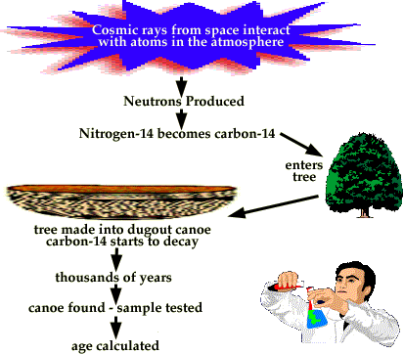
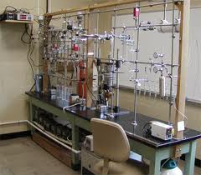
Radio-carbon dating
This method can be used to date many things including wood, soil, pottery, human remains and tools.

Slide 9
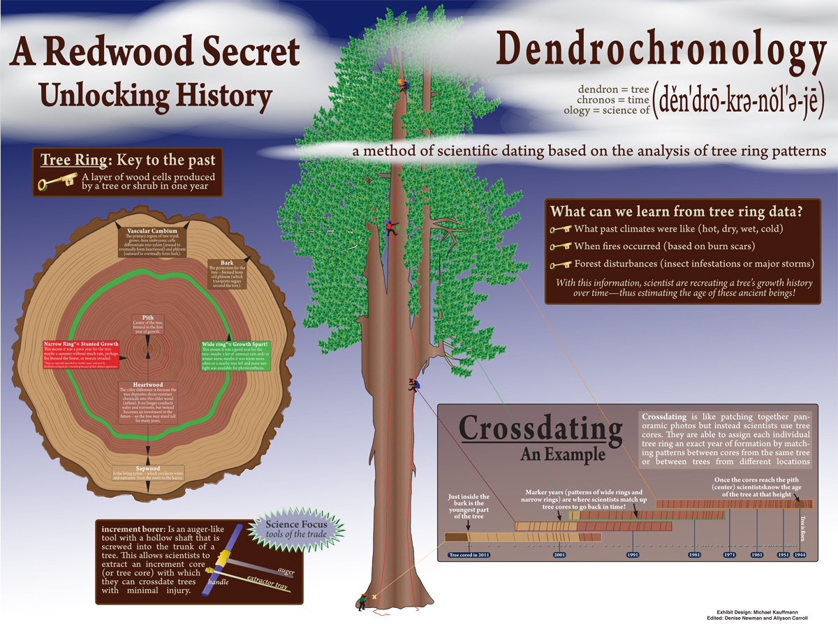
Dendrochronology (tree ring dating)

Slide 10
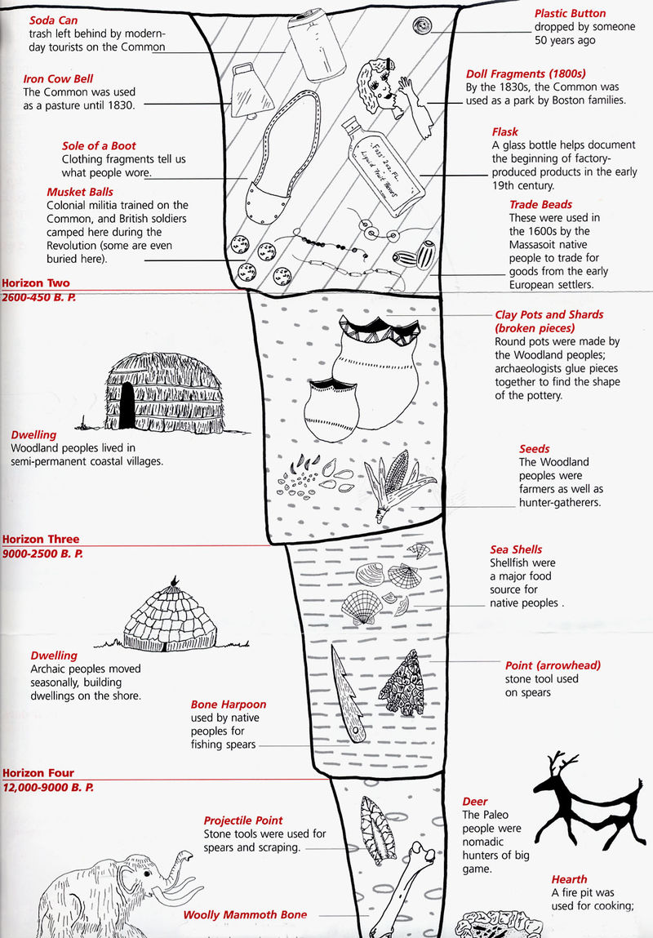
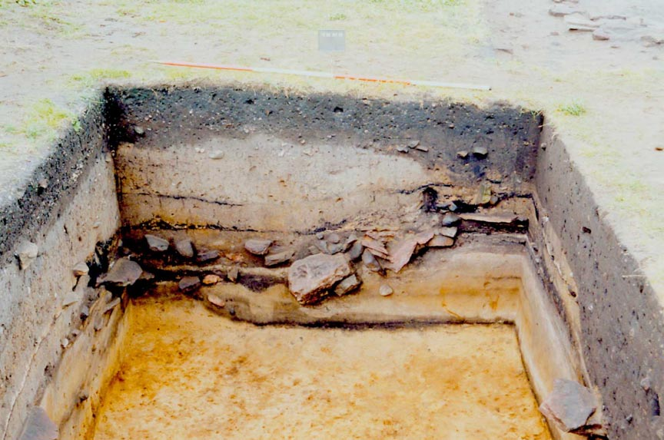
Stratigraphy
The layer of earth where an object is found can be used to date it. Unless the layers have been disturbed, the deeper the item, the older it is.

Slide 11
How do we know about early humans?
Evidence like the following is used to reconstruct the past.

Slide 12
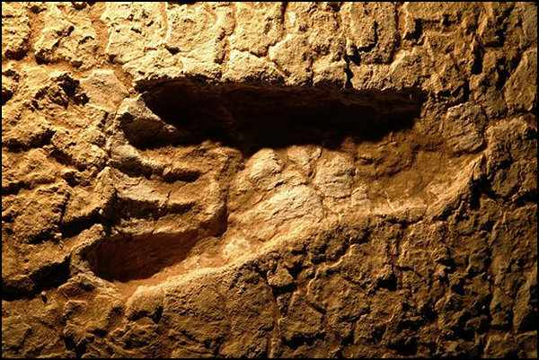
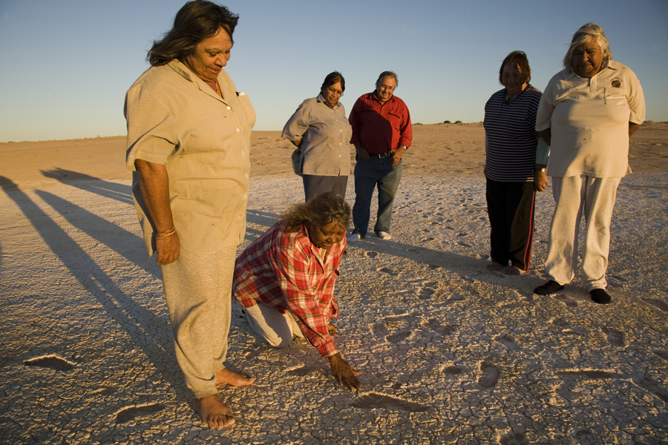
Footprints at Lake Mungo NSW show evidence of early humans in Australia
Scientists can also tell the ages of the people who left these prints and how fast they were moving (one even shows evidence of using a walking stick). Evidence shows they were mixed ages and running (and probably hunting).
Different dating methods have shown these footprints to be 30 000 to 60 000 years old. Therefore, humans have been in Australia at least this long.

Slide 13
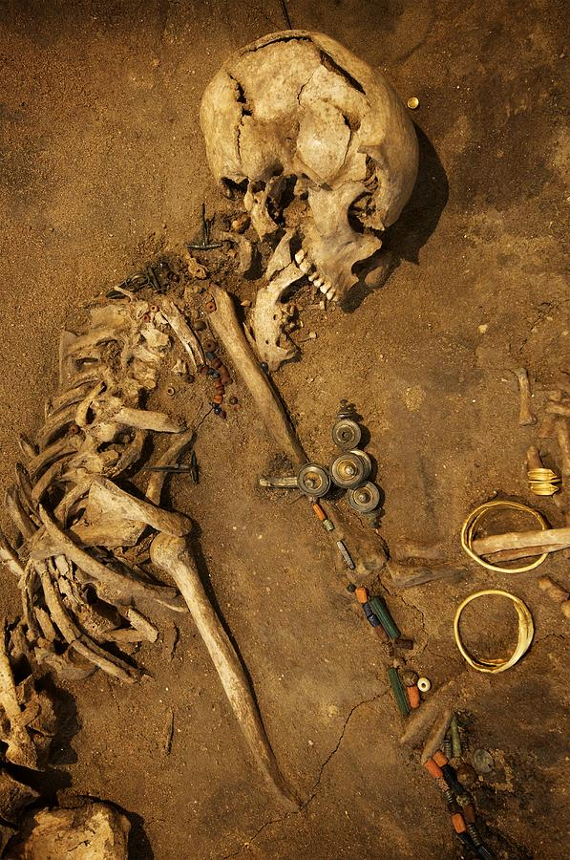
Prehistoric graves- more evidence of early humans
This prehistoric grave site gives archaeologists lots of information. What sort of clues and evidence can you see here and what might the clues reveal?
Yes- this burial can tell us things like:
-This person was buried with care & placed on their side with grave goods, which shows compassion and some sort of belief about burial or even an afterlife.
-These people knew how to use metal and decorated themselves with jewellery. They also had craft skills.
-Examination of the skeleton can tell us things like age, gender, health and nutrition of this person.
-Dating methods can tell us the time of the burial.

Slide 14
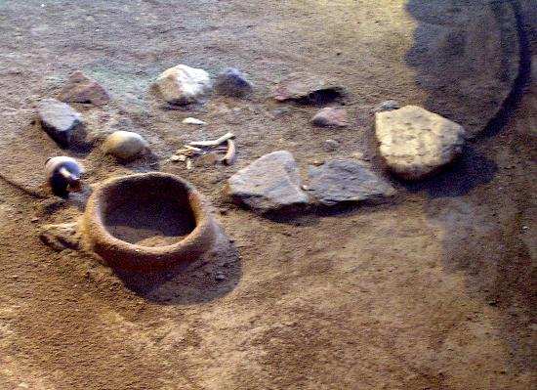
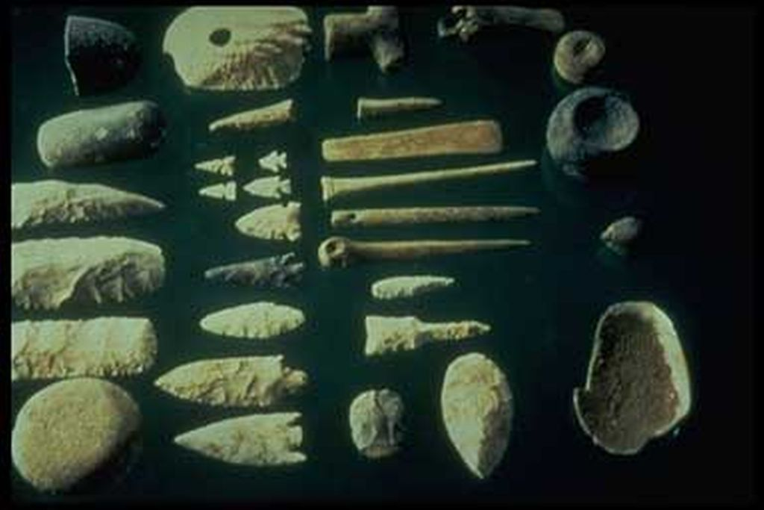
Ancient Tools
Ancient tools such as these provide evidence of humans living in an area and can also reveal things like hunting and food preparation techniques. Migration and trade can also be confirmed based on the ‘trail’ of tools as humans moved and the original origins of the materials used to make them. Dating of items can tell us ‘when’
If archaeologists found a 15000 year old stone tool in America made from rock only found in Russia, what might that suggest?
A- this could help to prove that humans were living in America at least 15000 years ago and that they either migrated from Russia where the rock came from or had traded it directly or indirectly with people from Russia.

Slide 15
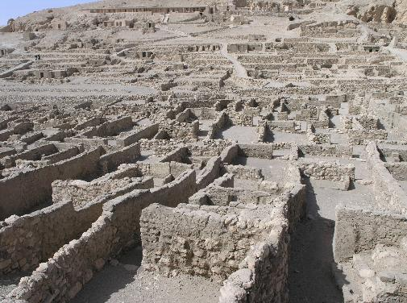
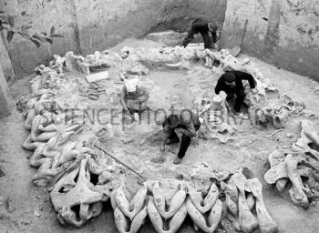
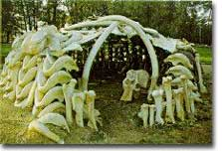
Ancient and Prehistoric Homes
A prehistoric mammoth hut being excavated in the Ukraine (above) and a modern reconstruction of this style of home (right)
Above- the ruins of a tomb builder’s village from Ancient Egypt near the Valley of the Kings.

Slide 16
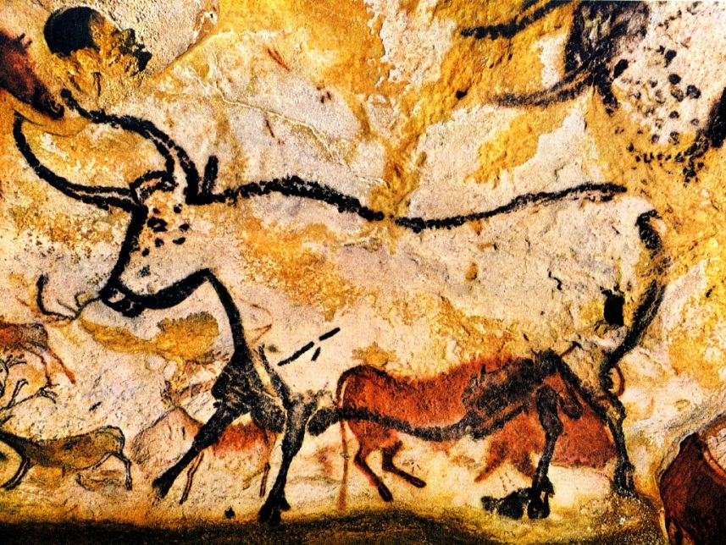
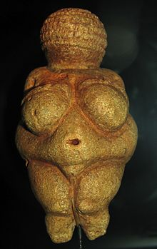
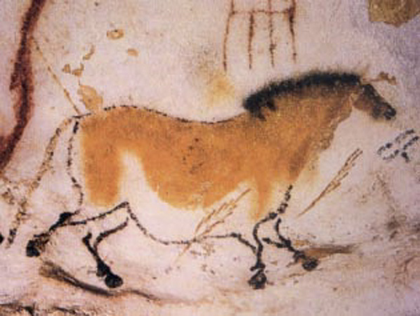
Artworks- evidence of our ancestors
Palaeolithic Cave Paintings in Lascaux
France are about 17 000 years old
This ‘Venus of Willendorf’ found in Austria is 27 000 to 30 000 years old. It is made of limestone of non-Austrian origin.

Slide 17
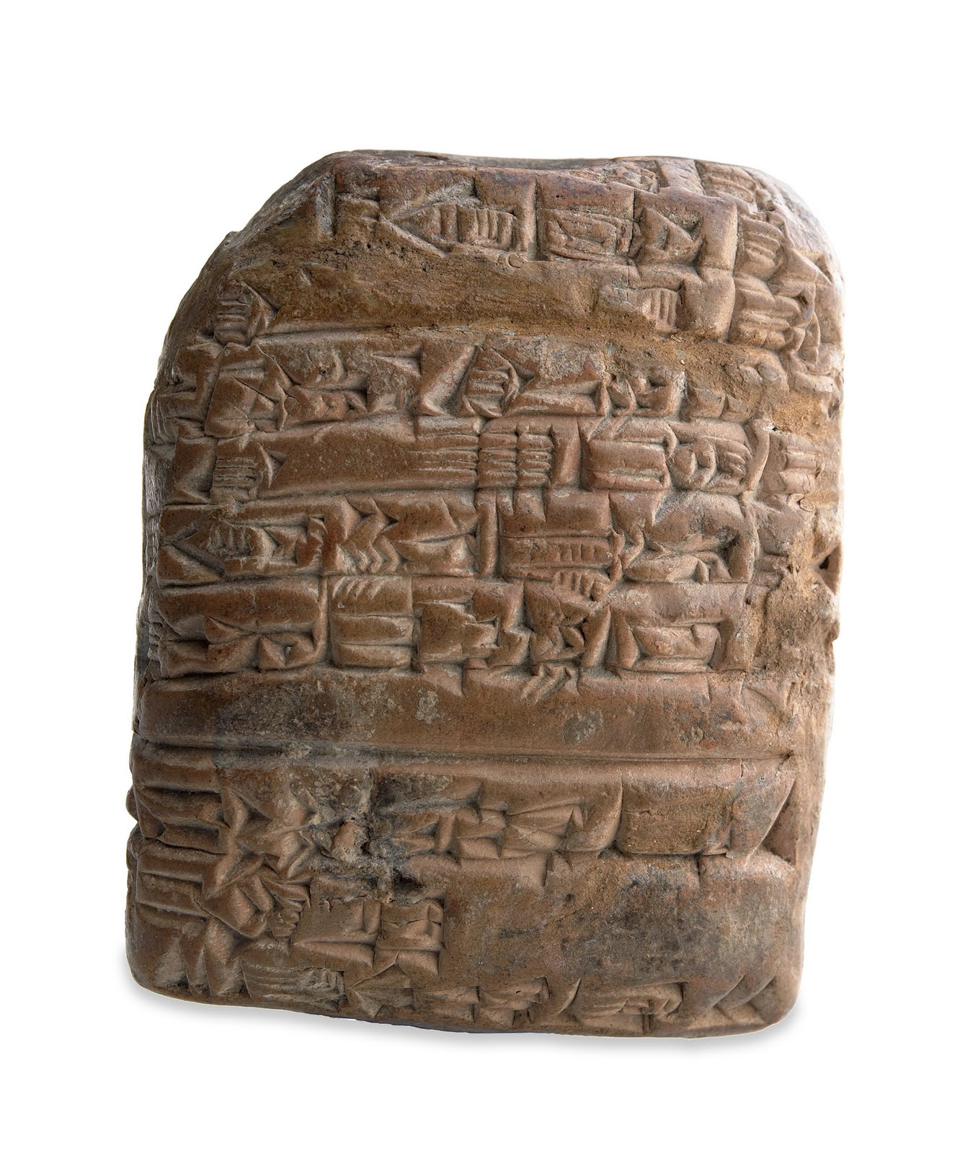
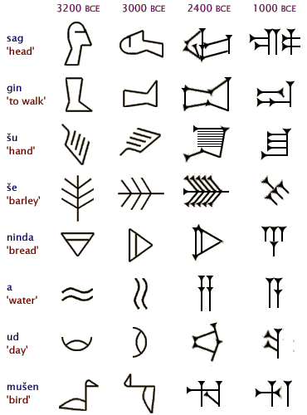
Ancient Texts
Ancient clay tablet of cuneiform writing from Mesopotamian circa 2050 BCE
What clues might this give us about early humans?

Slide 18
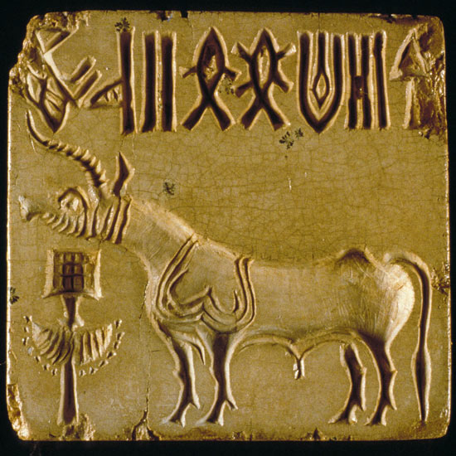
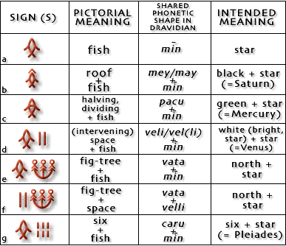
Early Writing
Some societies developed writing to keep records for:
-trade and transactions
-agricultural produce
-temple receipts in offerings
-tribute received (like a kind of tax paid in goods such as crops).
Harappan writing

Slide 19
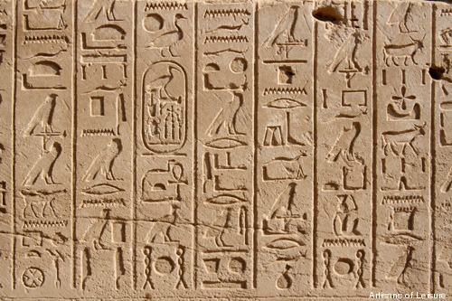
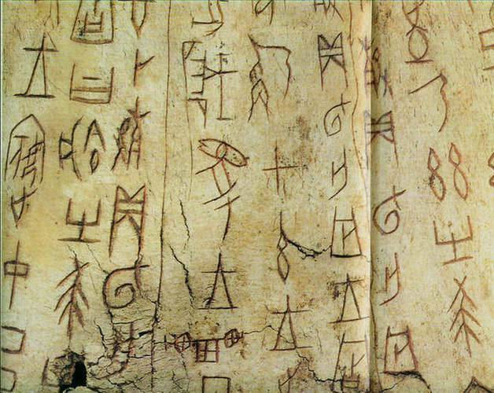
Early writing includes:
Sumer in ancient Mesopotamia (modern Iraq) around 3600 BCE where a triangular tool was used to press number symbols into clay. By 3000 BCE picture symbols were being added. This was cuneiform writing.
Indus Valley (India and Pakistan) Harappa script emerged around 3500 BCE.
Hieroglyphics Egypt 3200 BCE
Canaanite writing 1900 BCE in areas now known as Jordan, Lebanon & Israel.
China 1200 BCE
Central America 1000 BCE
Hieroglyphics Egypt
Early Chinese Writing

Slide 20
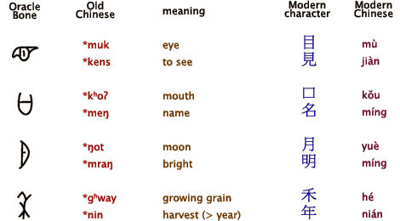
Archaeologists have been able to decipher some ancient writing but not others:

Slide 21
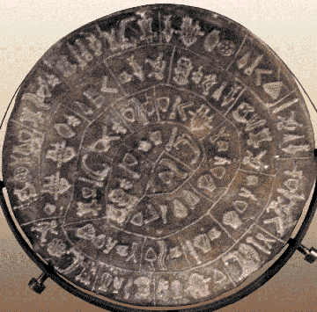
No one has yet been able to decipher the “Linear A” text from the ancient Minoans on Crete because we do not know their language. There are some similarities to the later Mycenaean “Linear B” though which may be a clue to help eventually solve this puzzle.

Slide 22
Discussion:
What difference would being able to decode ancient writing make to our understanding of past societies?

Slide 23
From the different clues found, the following has been discovered about early humans based on evidence:
*The earliest humans and their ancestors probably emerged in Africa. Skeletal remains indicate this.
*Humans were able to migrate out of Africa and spread due to lower seal levels in the last ice age that meant our continents were joined by land bridges that are now underwater.

Slide 24
*Humans were in Australia by 30 000 to 60 000 years ago (based on the trail of evidence left such as remains and tools).
*Based on traces of early humans in America, humans did not arrive there until about 15 000 years ago (possibly up to 35 000 years depending on dating).

Slide 25
*Humans have been in Europe for at least 27 000 years based on evidence such as cave paintings and artefacts such as the “Willendorf Venus”.
*Sometimes early humans didn’t get along as shown by some people who died from weapon wounds.
*Homo sapien sapiens made weapons, tools and jewellery. Early materials included stone, bone and obsidian (volcanic glass). Later (around 9500 BCE copper was discovered & used by beating natural ore).
* By 6000 BCE humans had learned to smelt copper.
*Over time techniques, tools and knowledge became more sophisticated as bronze then iron were discovered.

Slide 26
Copy and Answer the following based on what you have just learned:
Heading: Early Humans
Humans have lived in Australia for at least _____________ years. We know this because… (fill in your own answer).
Humans did not arrive in the Americas until at least 35 000 to ___________ years ago. We know this because … (fill in your own answer)
Two things we can learn from early human skeletons are… (fill in your own answer)
Early cave art in France is about ________________________ years old.
Two other types of early human artefacts are ____________________ and _________________.
Two things we can tell from evidence include:
(fill in your answer).

Slide 27
Check your answers:
Heading: Early Humans
Humans have lived in Australia for at least 60 000 – 30 000 years. We know this because of evidence such as Lake Mungo footprints, burial sites and ancient tools found.
Humans did not arrive in the Americas until at least 35 000 to 15 000 years ago. We know this because there is no trace of humans there before then.
Two things we can learn from early human skeletons are whether male or female and how old they were at death (other answers include diseases, injuries and beliefs based on how they were buried etc.).
Early cave art in France is about 17 000 years old.
Two other types of early human artefacts are tools and shelters (or artwork, graves, writing, weapons, jewellery, pottery etc) .
Two things we can tell from evidence include:
-How long people have lived in an area
-How people lived based on artefacts (other answers are also possible).

Slide 28
What do you think? Copy and complete the following:
1. I think early humans wore jewellery because…
2. Two reasons why I think early humans might have migrated to new places such as Australia and America are:
- __________________________
-___________________________
3. I think the development of metal helped early humans progress because…

Slide 29
Source Analysis
Historians and archaeologists ask questions about the past using evidence.
These questions are the ‘5 Ws + H’ of history (Who? What? Why? Where? When? How?).
Look at the following sources and complete the activities on your copy.

Slide 30
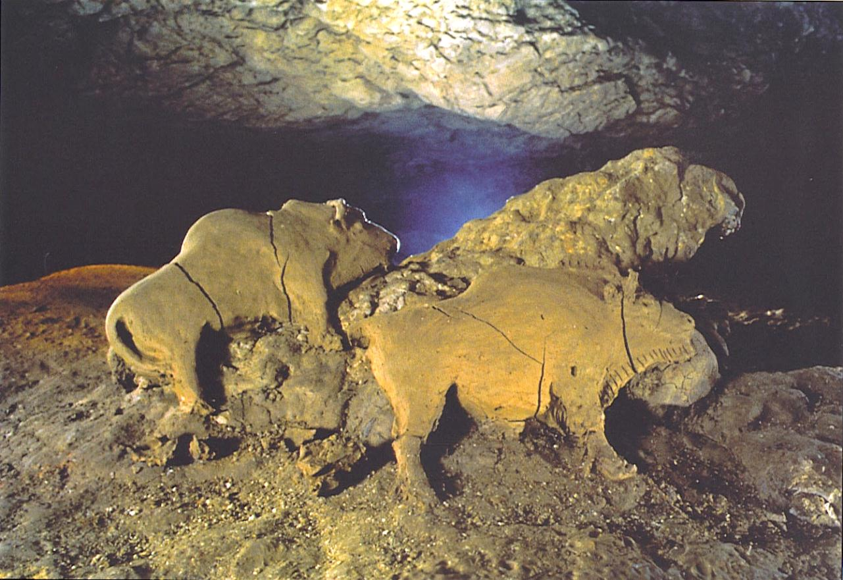
Source 1- Clay bison sculptures from Tuc d’Audobert Cave France are 10 000 to 14 000 years old
Compose 3 historical questions about this source and write them below:

Slide 31
Source 2
Remains of a Palaeolithic hut made of mammoth bones located in The Ukraine.
How and why might Source 2 be useful to a historian studying early humans in the Palaeolithic era? (that is, what types of things could be find out using this evidence?)

Slide 32
Make two historical judgements about any of these sources based on the evidence you have available.
Source number ___________
My historical judgement using the clues:
Source number ___________
My historical judgement using the clues:

Slide 33
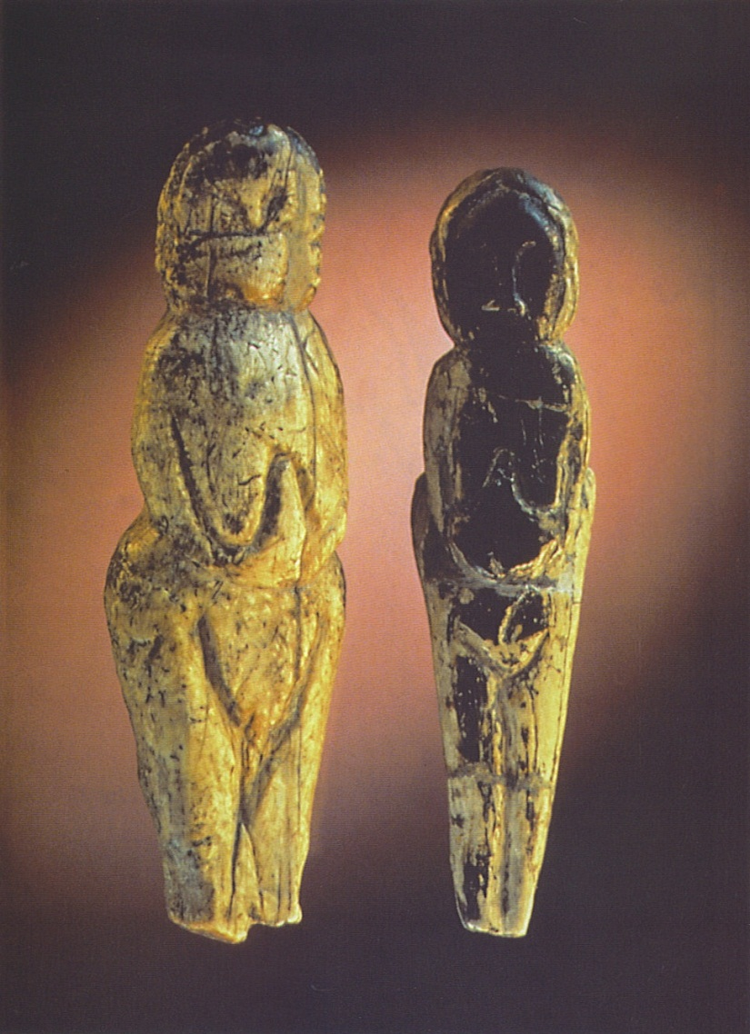
Source 3- two female figurines from Ice Age Malta that are about 14 000 years old.
What additional information might you need about these artefacts to be able to be able to develop historical theories about them? List two extra things you might need to know?
______________________________
______________________________
______________________________
______________________________

